Slide 1



Lockwood Water & Sewer District (LWSD)
INSTALLATION AND CONNECTION OF SEWER SERVICES
EPA EMERGING CONTAMINANTS (EC) REIMBURSEMENT GRANT PROGRAM
Public Meeting
December 16, 2025
(Updated 1/3/2026)

Slide 2
Introductions
Lockwood Water & Sewer District
Morrison-Maierle
WPCSRF/MDEQ

Slide 3
Meeting Objectives
Provide information on Lockwood’s program for installation and connection of sewer services under the EPA Emerging Contaminants (EC) Reimbursement Grant Program
Property owner process and requirements for participation in program
Process for contractors to be placed on an approved list of contractors eligible to install new sewer services as part of this program
Summarize construction requirements that eligible contractors must meet to participate

Slide 4
Emerging Contaminants Program
Emerging Contaminants funding:
EPA Montana Water Pollution Control State Revolving Fund Lockwood Water and Sewer District Contractor
The Emerging Contaminants Reimbursement Grant funding assists Lockwood Water and Sewer District property owners with the cost of connecting to the Lockwood sewer system to reduce Emerging Contaminants entering the groundwater

Slide 5
Emerging Contaminants Funding
Background: The Phase 1 and 2 Sewer Subdistrict projects are complete and installed sewer services mostly in public right-of-way from sewer mains to property lines. Phase 3 is anticipated to be completed over the next two years (2026-2027)
Where will sewer services be installed? On private properties located within the Phase 1 and 2 areas and future Phase 3 area, from existing service stub at property line to the business or residence sewer line
Who is eligible? Property owners in the Phase 1, 2, and 3 Sewer Subdistrict areas who have not yet connected to sewer. Must be in an area of completed sewer
  Phase 3 property owners cannot apply until Phase 3 is complete
How much funding is available? Up to $5,000 per property for approximately 180 properties, dependent on costs

Slide 6
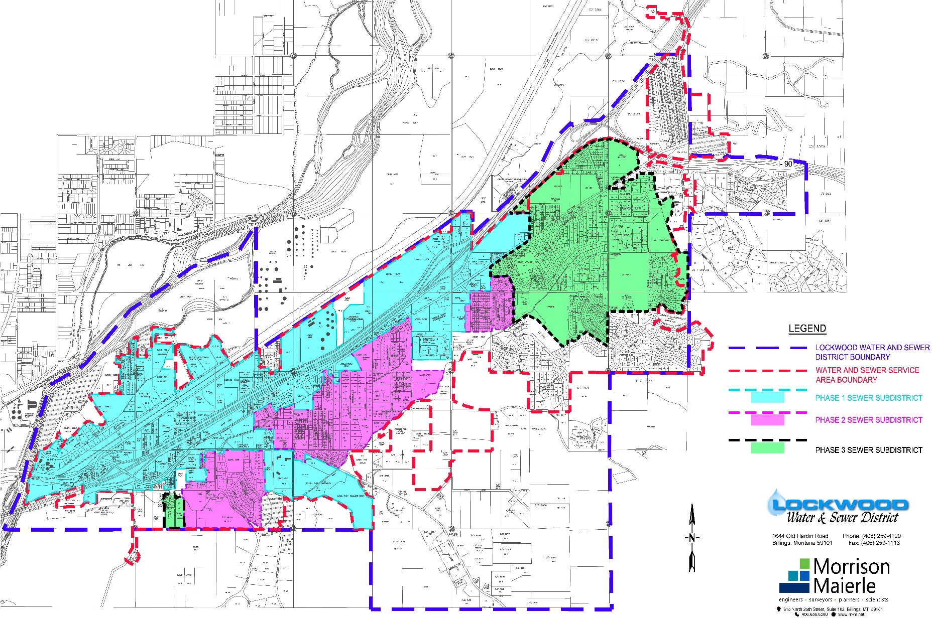
Ph 1, Ph 2, and Future Ph 3 Sewer Subdistrict Areas
Interstate 90
Johnson Ln
Yellowstone River

Slide 7
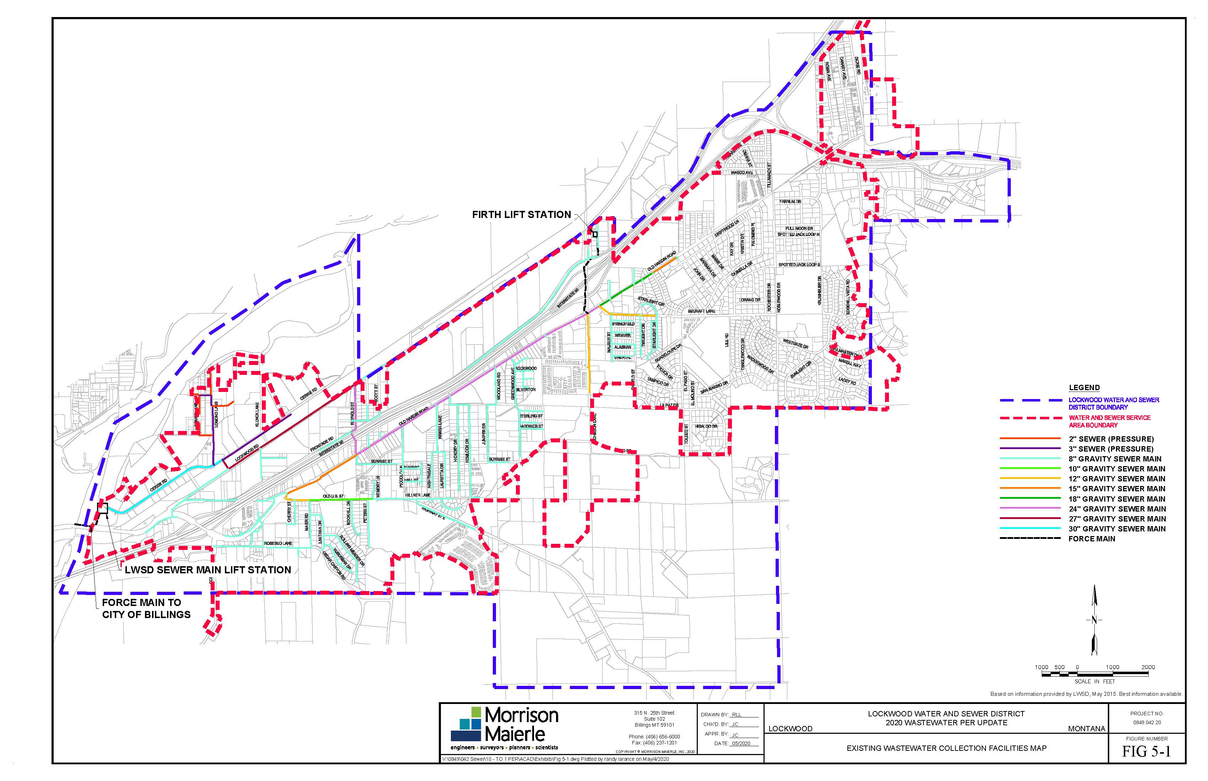
Existing Sewer – Phases 1 and 2

Slide 8
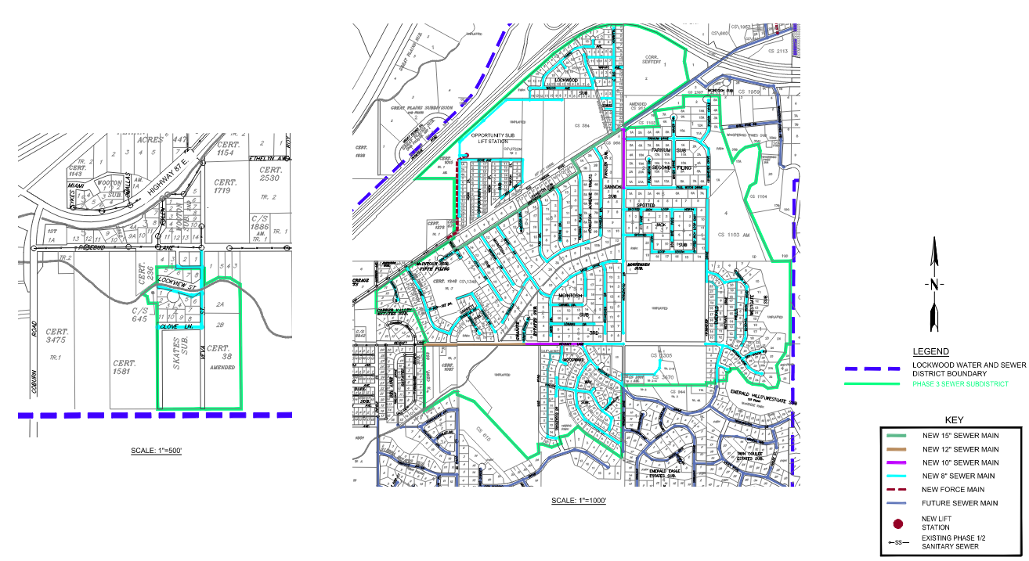
Future Sewer – Phase 3
Interstate 90
Old Hardin Rd
Rosebud Ln
Noblewood Dr
Becraft Ln

Slide 9
New Sewer Service Installation

Slide 10
Sewer service installation in this program consists of:
Connect to existing service stub out at property line – remove cap, connect, and install cleanout and box
Install 4” or 6” service from cleanout to business or residence and connect to sewer line upstream of septic tank, but at least 5 feet from the structure at location agreed to between contractor and property owner
Install grinder pump if required due to elevation difference
Abandon septic tank in compliance with Riverstone Health requirements
What is not included in this program?
Site restoration (property owner may complete this work or pay for it out of pocket)

Slide 11
Property Owner Process and Requirements

Slide 12
Step 1: Property Owner Determines Availability of Public Sewer
Step 2: Obtain Approved Contractor List from LWSD and Secure a Written Bid* from an Approved Contractor
Step 3: Sign and Return Grant Agreement to LWSD
Step 4: Grant Approval Notification from LWSD to Property Owner
Step 5: Property Owner Submits Service Application and Pays Required Connection Fees to LWSD
Step 6: Property Owner Contracts* with and Schedules On-site Work with Contractor
Step 7: Contractor Performs all Contracted Work
Step 8: Payment from LWSD to Contractor (up to $5k)
* It is highly recommended for property owner to require contractor bid and contract to exempt property owner from responsibility for costs if the contractor does not comply with program requirements and cannot receive reimbursement from LWSD

Slide 13
Property Owner Responsibilities

Slide 14
Determine eligibility, obtain grant agreement form from LWSD office or download from LWSD website, and obtain list of pre-approved contractors
Obtain bid(s) – (it is recommended to obtain more than one)
Apply to the program for funding by completing and submitting grant agreement
Hire an approved contractor
Pay all costs associated with sewer service installation
  $60 permit fee
  $45 account set-up
  System development fee based on sewer phase connection
  New sewer service installation cost less grant funding paid directly to the contractor (any cost above $5k, or extra for restoration)

Slide 15
Timelines
  Construction must be complete w/in 9 months of date of approved grant agreement
  Contractor submits closeout documents to LWSD w/in 45 days of construction completion
  LWSD makes payment to Contractor w/in approximately 45 days of receipt of closeout documents
  Total timeframe = one year (max)

Slide 16
Approved Contractors List
How does a contractor get on the approved contractors list?
Submit the following to LWSD:
  Montana State registration
  Liability insurance certificate with LWSD and Morrison Maierle listed as Additional Insureds
  EC Reimbursement Grant Program Contractor’s agreement form
  Debarment certification form

Slide 17
Construction Reimbursement Requirements for Contractors
Pay all required fees and receive any required permits
Provide schedule and schedule LWSD inspection prior to backfilling
Complete all items in the bid and agreement with property owner
Purchase and use materials that are BABAA compliant
Pay the higher of current Federal Davis-Bacon Act or current Montana Prevailing Wage Rates
Submit certified payrolls
Cooperate with LWSD staff or authorized representative to verify BABAA and wage rate requirements through site visit and labor interviews

Slide 18
Construction Reimbursement Requirements for Contractors
Provide the following for payment and project close-out:
BABAA Contractor’s Certification Form
BABAA Manufacturer’s Certification Forms
Wage Rate Certification Form
Septic System Abandonment Form
Final Invoice
IRS W-9 Form
Grant funding payment to Contractor will be processed after connection completion and submittal of above documents.

Slide 19
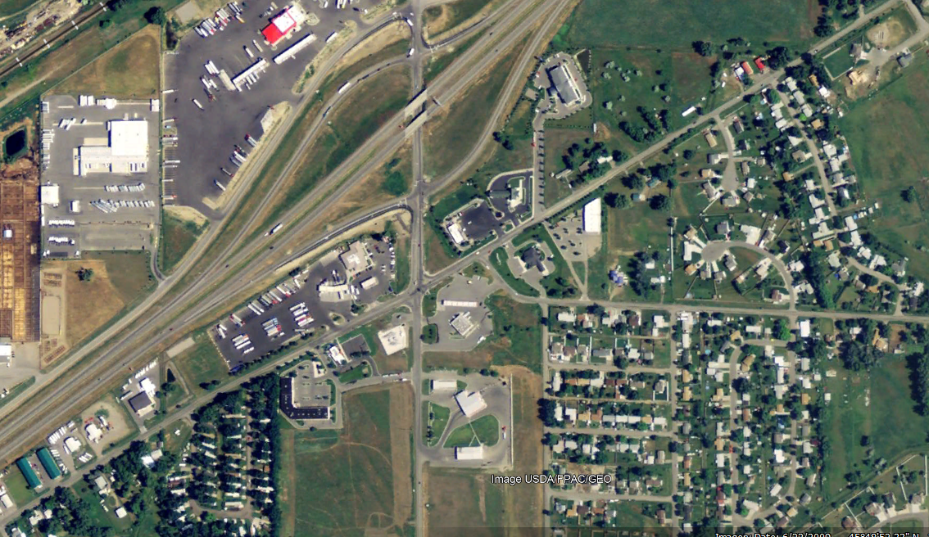
Lockwood Water and Sewer District
Emerging Contaminants Program
Questions?

